Slide 1
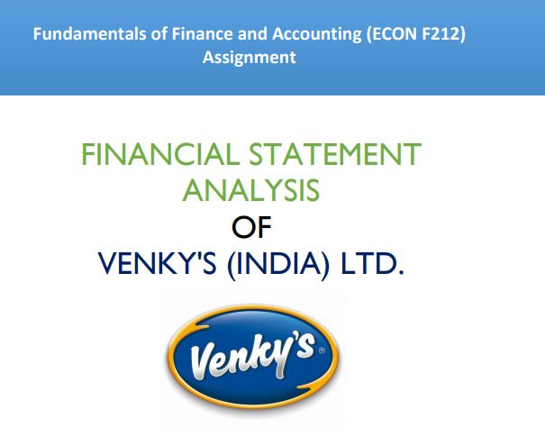

Slide 2
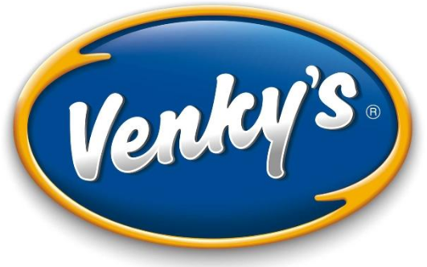
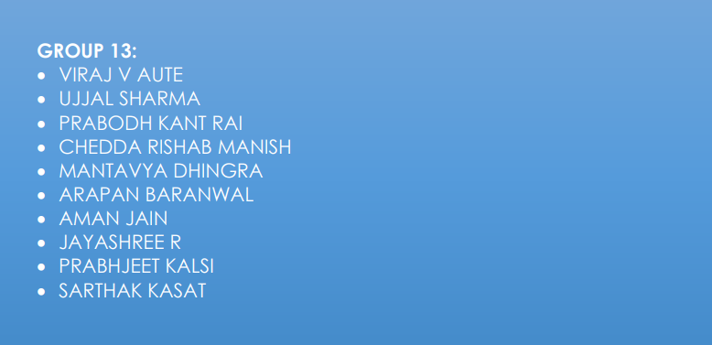

Slide 3
The VH group was established in 1971 by Padmashree Dr. B.V. Rao. VH group stands for Venkateshwara Hatcheries group. Today the group is popularly known the world over as “Venky’s”. The company produces diversified products like Specific Pathogen Free Eggs, chickens and eggs, broiler and layer breading etc.

Slide 4
BUSINESS PRODUCTS
ANIMAL HEALTHCARE PRODUCTS
BIO SECURITY PRODUCTS
BIOTECH PRODUCTS
HUMAN HEALTHCARE PRODUCTS
EGG POWDER
FMCG
VH BREED
FEED SUPPLEMENTS

Slide 5
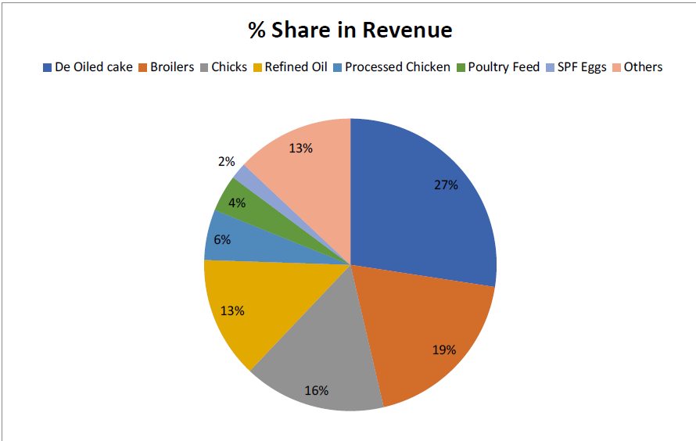
SEGMENT WISE REVENUE

Slide 6
BUSINESSES
Venkateshwara Hatcheries Pvt. Ltd.
Venky's (India) Limited
VENCO
VRB
B.V.Bio-Corp Pvt. Ltd.
Uttara Foods & Feeds Pvt. Ltd.
Uttara Impex Pvt. Ltd.
Eastern Hatcheries Ltd.
Venky's Brazil Ltd.
Venky's London Ltd.

Slide 7
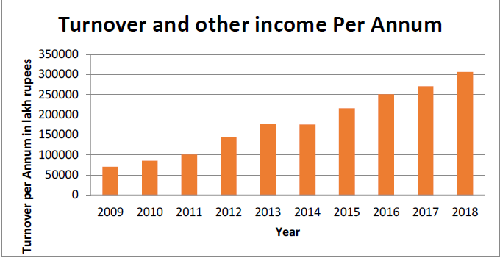
OVERALL GROWTH

Slide 8
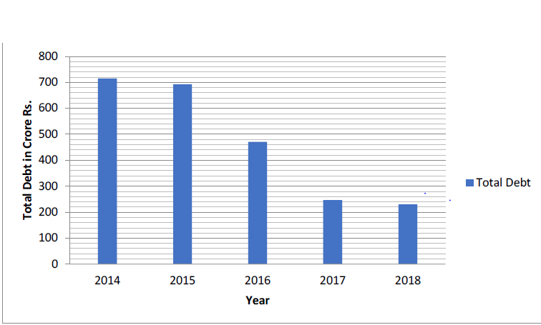
OVERALL GROWTH

Slide 9
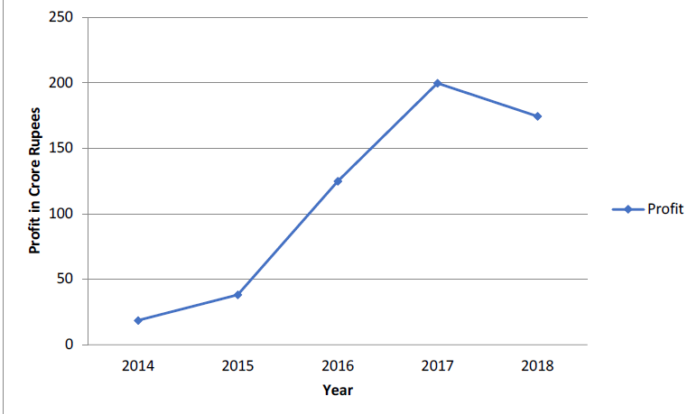
OVERALL GROWTH

Slide 10
PARTS OF THE ANNUAL REPORT
Venky’s annual report 2018-19 is divided into the following categories:
Introduction:
Notice
Director's Report
Management Discussion and Analysis Report
Report on Corporate Governance
Auditor’s Report

Slide 11
PARTS OF THE ANNUAL REPORT
Balance Sheet
A balance sheet is a financial statement that reports a company's assets, liabilities and shareholders' equity at a specific point in time, and provides a basis for computing rates of return and evaluating its capital structure.
P&L Statement
The profit and loss (P&L) statement is a financial statement that summarizes the revenues, costs, and expenses incurred during a specified period, usually a fiscal quarter or year.

Slide 12
PARTS OF THE ANNUAL REPORT
Cash Flow Statement
The statement of cash flows, or the cash flow statement, is a financial statement that summarizes the amount of cash and cash equivalents entering and leaving a company.
The Statement of Changes in Equity
The statement of changes in equity is a reconciliation of the beginning and ending balances in a company’s equity during a reporting period.

Slide 13
PARTS OF THE ANNUAL REPORT
Policies
Dividend Distribution Policy
Business Responsibility Report

Slide 14
LIQUIDITY RATIOS
Liquidity ratios are a financial metric that measures a company’s ability to pay its short-term debts.
Liquidity ratios compare a company’s most liquid asset to its short-term liability.
The most commonly used liquidity ratios are current ratio, quick ratio and operating cash flow ratio.

Slide 15
LIQUIDITY RATIOS
Current Ratio
The current ratio is a liquidity ratio that measures a company's ability to pay short-term obligations or those due within one year.
It tells investors and analysts how a company can maximize the current assets on its balance sheet to satisfy its current debt and other payables.
Current Ratio= Current Assets/Current Liabilities
Current Ratio = (89,034.84/58,768.30)=1.515
Current Ratio > 1.5 is consider as safe

Slide 16
LIQUIDITY RATIOS
Operating Cashflow Ratio
The operating cash flow ratio is a measure of how well current liabilities are covered by the cash flows generated from a company's operations.
Using cash flow as opposed to net income is considered a cleaner or more accurate measure since earnings are more easily manipulated.
Operating cash flow ratio=Operating cash flow/ Current liabilities
Operating Cash flow ratio= (15,890.72/58,768.30)=0.27039
If Operating Cash flow ratio<1 then the company generated less cash from operations than is needed to pay off its short-term liabilities, signalling short term problems.

Slide 17
LIQUIDITY RATIOS
Quick Ratio
The quick ratio is an indicator of a company’s short-term liquidity position and measures a company’s ability to meet its short-term obligations with its most liquid assets.
If the acid-test ratio is much lower than the current ratio, it means that a company's current assets are highly dependent on inventory.
Quick ratio= (Current Assets - Inventory - Prepaid Expenses)/
Current liabilities
Quick Ratio= ((89,034.84 – 20,883.96 – 0)/58,768.80)=1.1596
Quick Ratio between 1 and 1.5 is considered good.

Slide 18
DEBTOR’S TURNOVER RATIO
The Debtors Turnover Ratio also called as Receivables Turnover Ratio shows how quickly the credit sales are converted into the cash. This ratio measures the efficiency of a firm in managing and collecting the credit issued to the customers.
Debtors Turnover Ratio = Net Credit Sales/Average Account Receivable.
Average Account Receivable = (Opening balance of account receivable + Closing balance of account receivable)/2

Slide 19
DEBTOR’S TURNOVER RATIO
Average Account Receivable = (29,542.74 +30,554.92 )/2 = 30,048.83 Lakh Rupees
Net Credit Sales (we take net sales as net credit sales as we assume all the sales were made on credit) = 304313.51 Lakh Rupees
Venky’s is one of the companies that do not report cash and credit sales separately.
Debtors Turnover Ratio (Mar’ 19) = 304313.51/30048.83 = 10.13

Slide 20
DEBTOR’S TURNOVER RATIO
The higher the Ratio the better it is. It must be compared with the firms that have similar business operations and revenue and lie in the same industry.
Also we would divide the ratio of 10.13 by 365 days to arrive at the average duration. The average accounts receivable turnover in days would be 365 / 10.13 or 36.03 days.
For the year Mar’ 19, the industry receivable days were 42.42. Correspondingly the debtors turnover ratio is 8.6. The venky’s number is better than the industry average as a higher ratio is always better. But not so much high that will push away customers to buy on credit.

Slide 21
RETURN ON SHAREHOLDER’S EQUITY
The return on shareholder’s equity shows how much money is returned to owners as a percentage of the money they have invested or retained in the company.
It is calculated by dividing a company’s earnings after taxes by the total shareholder’s equity.
Return on Equity = Net Income/Average Shareholder’s Equity

Slide 22
RETURN ON SHAREHOLDER’S EQUITY
What does ROE show?
The return on shareholders’ equity ratio is used to track a company’s performance over time or to compare businesses within the same industry. The higher the percentage, the more money is being returned to investors.
A company’s performance is said to be good if its ROE is greater than the industry’s average ROE.

Slide 23
From the profit and loss statement,
Earnings after tax (EAT) or Net Income = Rs 17,414.07 lakhs.
From the balance sheet,
Shareholder’s equity or Total Equity = Rs 88,149.23 lakhs
Return on Shareholder’s Equity = (17,414.07)/(88,149.23)
= 19.8%
Industry’s Average ROE = 8.7%
The ROE of Venkys is higher than its peers in food industry which is clearly a positive sign.

Slide 24
CSR ACTIVITIES
According to CSR law in Companies Act 2013 , companies with a net worth of Rs 500 crore or more, or turnover of Rs 1,000 crore or more, or net profit of Rs 5 crore or more were required to spend 2 per cent of their average profit of the previous three years on CSR activities every year.

Slide 25
CSR ACTIVITIES
Charitable organisations associated:
Lord Venkateshwara Charitable Trust
Smt. Uttara Devi Charitable & Research Foundations
Programs undertaken by Venky’s :
Education and Employment
Eradicating Hunger, Poverty and Encouraging Sports
Promotion of Healthcare

Slide 26
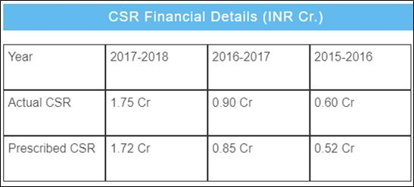
CSR ACTIVITIES

Slide 27
FUNDING
Sources of Funds
Particular | Amount (in RS crore)
Share Capital | 14.09
Reserves | 867.40
Total Shareholders’ Funds | 881.49
Secured loans | 203.33
Unsecured loans | 77.28
Total Debt | 280.61
Total Liabilities | 1162.10

Slide 28
DEBT VS EQUITY
Debt | Equity
It involves selling of debt instruments to individuals or investors with a promise to repay the capital along with interest. | It involves selling the company stock for which the investors gain ownership in the company.
Debt instruments include bonds, bills, debentures and so on. | Equity instruments include preferred stock, common shares and so on.
The interest paid is tax deductible. | The dividends paid are not tax deductible.

Slide 29
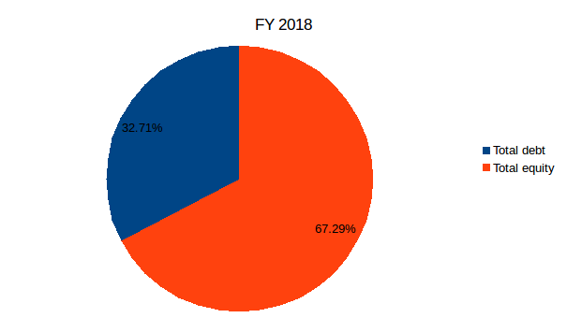
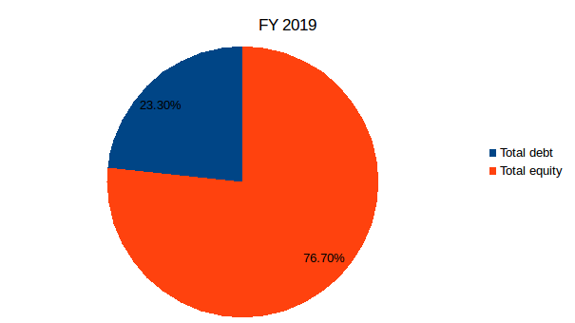
DEBT VS EQUITY
Debt to equity ratio = 0.49
Debt to equity ratio = 0.30

Slide 30
SECURED AND UNSECURED LOANS
Secured loans | Unsecured loans
Loans and advances from banks or subsidiaries or others, obtained by a company after creation of charge on its assets. | Loans and advances from banks or subsidiaries or others, obtained by a company without creation of charge on its assets.
These loans are backed by collateral. | Money which is borrowed without collateral.
They also include debentures. | They also include fixed deposits received from the public.

Slide 31
SECURED AND UNSECURED LOANS
For the financial year ending on 31st March 2019,
Total Unsecured loans = 77 Rs. (in crores)
Total secured loans = 203.33 Rs. (in crores)

Slide 32
INVENTORIES POSITION
Inventories position gives the amount of inventory in hand with the company. Its change gives an idea of the company’s consumption and sales over the years.
Cost of Inventory (raw and packing materials) consumed in FY 2017-18= Rs 169,412.59 lakhs
Cost of Inventory consumed in FY 2018-19= Rs 206,919.83 lakhs
Change in cost of inventory consumed = 216,919.83 – 169,412.59 = Rs 47,507.24
Percentage change in cost of inventory consumption = ((206,919.83-169,412.59)/ 169,412.59) * 100 = 22.139%

Slide 33
INVENTORIES POSITION
Closing value of Inventories as at 31st March, 2019 = Rs 20,883.96 lakhs
Closing value of Inventories as at 31st March, 2018 = Rs 16,220.14 lakhs
Change in the closing value of inventories =20,883.96–16,220.14=Rs 4,663.82 lakhs
Percentage changes in inventories = ((20,883.96-16,220.14)/ 16,220.14)*100 = 28.753%
The increase in the closing value of the inventories indicates that Venky’s wasn’t able to sell as much as they were expecting in FY 2018-19

Slide 34
COST OF DEBT AND COST OF OWNER’S EQUITY
Debt holders | Equity holders
Receive a contractual obligation to be repaid their capital | Do not receive any contractual obligation to be repaid their capital
Receive fixed interest | Uncertainty of receiving dividends
Debt is secured against securities | Equity is not secured against securities
Since the risk faced by equity holders is more compared to the debt holders, therefore greater risk brings greater returns and thereby greater cost of owner’s equity is higher to cost of debt.

Slide 35
COST OF DEBT AND COST OF OWNER’S EQUITY
For Venky’s, in 2018-19:
Cost of debt = (Interest expense for 2018-19 * (1-t)) / (Total debt)
= (3137.74 * (1 – 34.944%)) / (26761.60)
=7.63%
Cost of equity = (Expected dividends next year / Market price) + Growth rate in dividends
=((8*(1+0.1333))/3249.88) + 0.1333
=13.61%

Slide 36
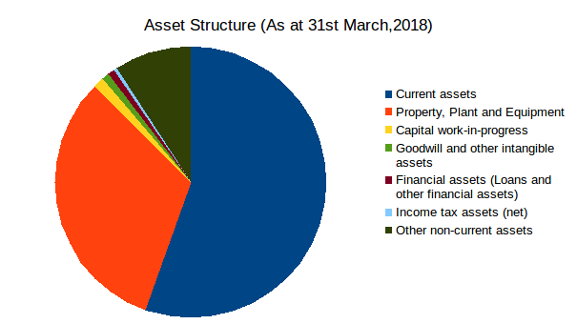
ASSET STRUCTURE

Slide 37
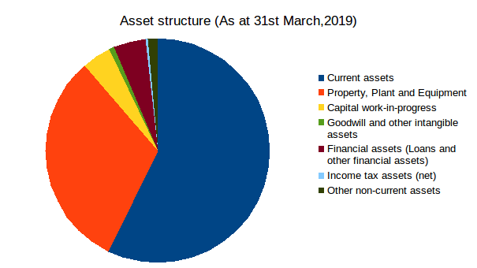
ASSET STRUCTURE

Slide 38
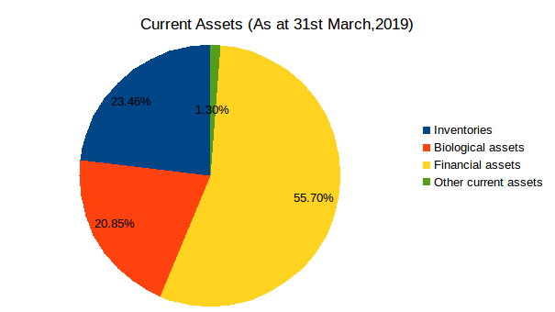
ASSET STRUCTURE

Slide 39
ASSET STRUCTURE
% of current assets is very high in the asset structure of Venky's compared to the fixed assets.
Venky's is involved in the production and sale of day old broiler and layer chicks and it produces poultry products.
Therefore, it has a large inventory and large number of biological assets leading to higher current assets.

Slide 40
GROSS PROFIT MARGIN
Gross profit margin is a parameter used to assess a company's financial health and business model by revealing the amount of money left over from sales after deducting the cost of goods sold.
Gross profit only includes variable cost and not fixed costs.
Formula of calculating the Gross profit margin is
Gross Profit Margin = (Revenue(net sales) – Cost of Goods Sold)/Revenue(net sales)

Slide 41
For the Financial Year ending 31st March 2019,
From Annual Report:
Revenue (net Sales) = 304313.51 Lakh Rupees
Cost of Goods Sold = 2,27,496.79 Lakh Rupees
Gross Profit = 76,816.72 lakh rupees
Gross Profit Margin = Gross Profit/Cost of Goods Sold = 25.2 %
As per industry standard it is not a good gross profit margin. For food industry 50-60% gross profit margin is considered good.

Slide 42
REVENUE TRENDS

Slide 43
REVENUE TRENDS
Reasons for growth in Revenue Trends:
Increasing Incomes and Changing Food Habits of Consumers
Growth in the Food Services Market
Increase in demand of Bakery Products

Slide 44
OPERATING PROFIT TRENDS

Slide 45
OPERATING PROFIT TRENDS
Reason for decline in profit in 2018-19:
Increase in costs of poultry feed ingredients
Expansion projects of solvent extraction plant and vegetable oil refinery in Maharashtra
Expansion of Specific Pathogen Free Eggs capacity by setting up a new production unit.

Slide 46
CASH POSITION
A cash position represents the amount of cash that a company has at a specific point in time.
The cash position is an indicator of financial strength and liquidity.
A cash position can also be found by looking at a company's free cash flow (FCF).

Slide 47
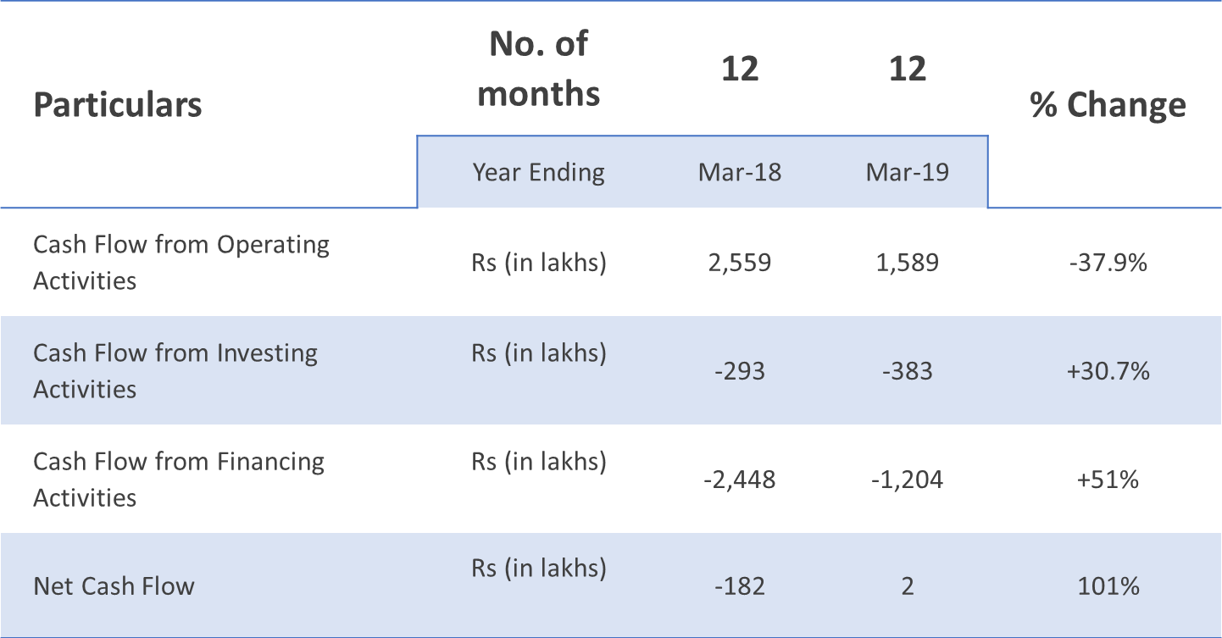
CASH POSITION
Cash Flow Statement 2018-19

Slide 48
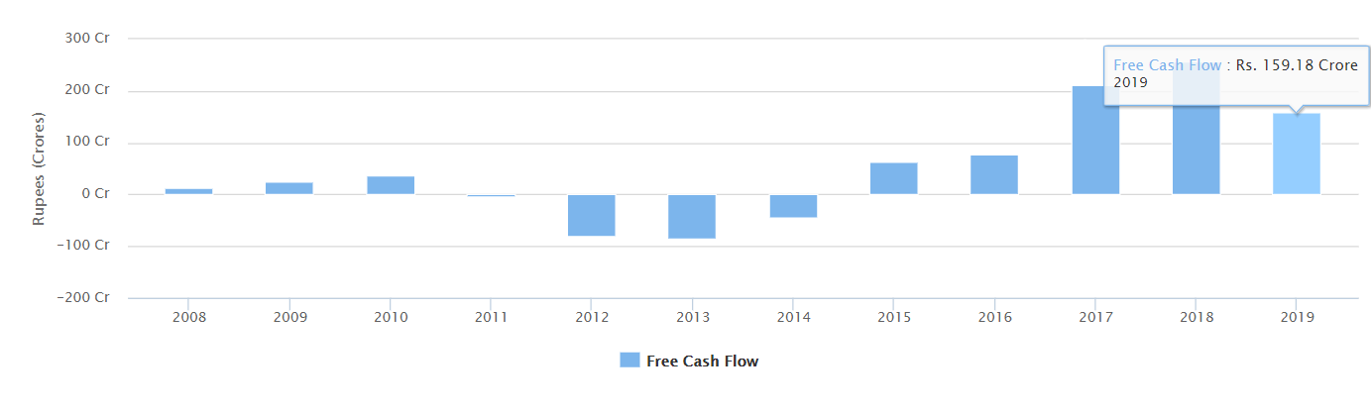
CASH POSITION
Free Cash Flow over past 10 years

Slide 49
CASH POSITION
The FCF is not to high nor to low of venky’s
An exceedingly high FCF indicates that the company is not investing in its business properly, such as updating its plant and equipment

Slide 50


